Slide 1
Lecture 13
Introduction to Databases

Slide 2




Map
Getting Started
Front End
Back End
Advanced Topics
Introduction
Fundamentals
Git
Command Line
HTML
CSS
Responsive Design
JavaScript & jQuery
Web Frameworks
Architecture
Database Design
APIs
Visualization
Security
Deployment
Notes:
This is the course map for IOLab 2016
We have packaged the course in f
Open up netflix and utube
our modules

Slide 3
Map
Getting Started
Front End
Back End
Advanced Topics
Introduction
Fundamentals
Git
Command Line
HTML
CSS
Responsive Design
JavaScript & jQuery
Web Frameworks
Architecture
Database Design
APIs
Visualization
Security
Deployment
Notes:
This is the course map for IOLab 2016
We have packaged the course in four modules

Slide 4
Today
Overview – DB Module
Databases-concepts
Deep dive – Relational Databases
Lab

Slide 5
Overview – DB Module
Lecture 1
Introduction and Concepts
Lecture 2
Applications through ORM
Lecture 3
NoSQL vs SQL
When to use what
ER Modelling
Relational
Mongo
SQL-Alchemy
Application through SQL

Slide 6
DATABASES - Concepts

Slide 7

Case Study - University Database
Students
Teachers
Classes
Departments

Slide 8
Why databases ? Why not Text files ?
Performance – speed of reading and writing
Scaling up – text files are terrible
DBMS – UI tools for majority of use-cases
Privileges, migrations, backups etc..
SQL !

Slide 9
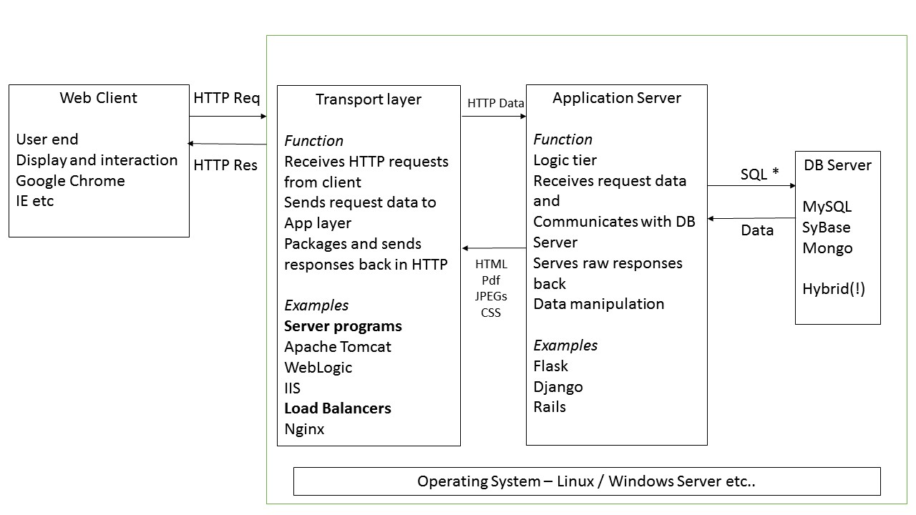
Web Server
App Server
FLASK
Client Side
Server Side
Notes:
Three servers here
Architectural thinking
Tell people to read about SQL

Slide 10
CRUD
CREATE
READ
UPDATE
DELETE
Application
Server
Database
Language

Slide 11
Read
SQL
Application
Server
Database
DATA

Slide 12
Read
Wrapper
SQL
Application
Server
Database
DATA

Slide 13
Design process

Slide 14
The 6 Dimensions of an Organizing System
What Is Being Organized?
Why Is It Being Organized?
How Much Is It Being Organized?
When Is It Being Organized?
Who (or What) is Organizing It?
Where is it Organized?
14
Notes:
Big focus tdo : storing information dictates what interactions u enable: cognizant of that

Slide 15
Logical Design
Technical Design
Who are you designing it for
What are their key goals
User stories
Models and Schema
Metrics

Slide 16
Example requirements - university
“As a University Dean, I need access to records of all our students, so that we can store and verify them in the future
“As a CS 170 Professor , I need list of students in my class, so that I can communicate with them effectively”
“As a University Admin, I need list of all classes across departments so that I can update course offerings”

Slide 17
Example requirements - university
“As a University Dean, I need access to records of all our students, so that we can store and verify them in the future
“As a CS 170 Professor , I need list of students in my class, so that I can communicate with them effectively”
“As a University Admin, I need list of all classes across departments so that I can update course offerings”
What resources your system has to organize
What interactions your system has to support
DATABASE MODEL

Slide 18
Database Modelling – a design problem
“Why is Design Overlooked?”
Simply, for two reasons:
It's difficult to perform correctly
It takes time (and sometimes lots of it)
https://dev.mysql.com/tech-resources/articles/why-data-modeling.html
Notes:
https://dev.mysql.com/tech-resources/articles/why-data-modeling.html

Slide 19
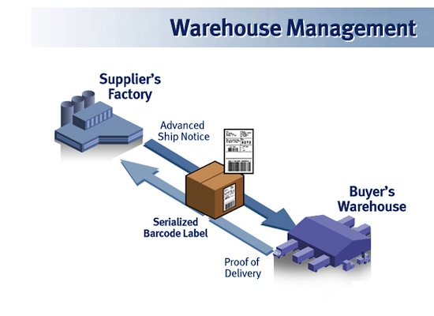
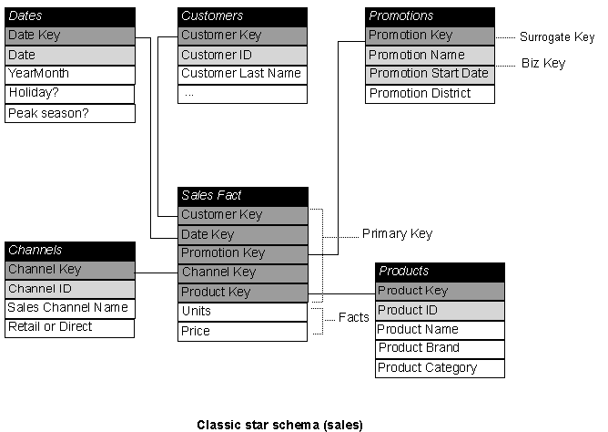
Database Models and Schemes
Models help ‘digitize’ the real world
Images: gxs.co.uk, Microsoft technet
Notes:
Database Models, Schemes and Instances
With the help of databases facts and processes from the real world should be described and stored in digital form. The abstraction from the real world to the digital format is done with the help of models, so called database models. In this unit, the most often used database models are presented. Following, database schemes are introduced as a formal description of a concrete database and their database instances or their database state. [GITTA]

Slide 20
ER Model
Entity Relationship Model
Models an enterprise as a collection of entities and relationships
Entity: a “thing” or “object” in the enterprise that is distinguishable from other objects
Described by a set of attributes
Relationship: an association among several entities
Represented diagrammatically by an entity-relationship diagram:

Slide 21
Relational Databases
ENTITY
ATTRIBUTE
RELATIONSHIP
KEYS
Tables,

Slide 22
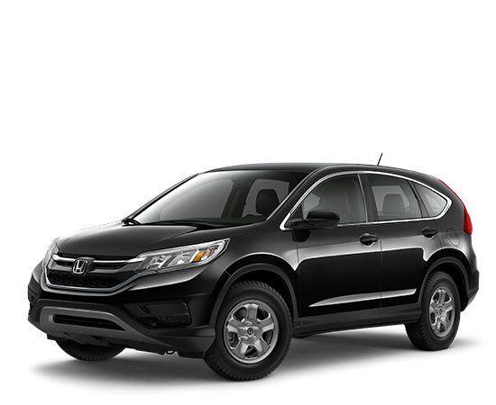

Relational Databases
ENTITY is a specific object
ATTRIBUTE
RELATIONSHIP
KEYS
Tables,
VIN – 771001938-2016
ISBN 7329091XXA
ENTITY SETS – TDO BOOK, Honda CRV 2016
Notes:
An entity is an object that exists and is distinguishable from other objects.
Example: specific person, company, event, plant
An entity set is a set of entities of the same type that share the same properties

Slide 23
“Thing” vs. “Type of Thing”
We often blur the distinction between individual things (or instances of things) and classes of things
We say that that two objects are the "same thing" when we mean they are the same "type of thing“
Identifying a resource as an instance is not the same as identifying the category or "equivalence class" to which it belongs
23

Slide 24
Relational Databases
ENTITY is a specific object
ATTRIBUTE
RELATIONSHIP
KEYS
Tables,
VIN – 771001938-2016
ISBN 7329091XXA
ENTITY SETS – TDO BOOK, Honda CRV 2016
Notes:
An entity is an object that exists and is distinguishable from other objects.
Example: specific person, company, event, plant
An entity set is a set of entities of the same type that share the same properties

Slide 25
Relational Databases
ENTITY is a specific object
ATTRIBUTE is a property
RELATIONSHIP
KEYS
Tables,
VIN – 771001938-2016
Dealer-
COST-
Mileage-
ISBN 7329091XXA
Owner
No. of pages
Autographed by
Simple , composite , single-valued, multi-valued, derived
Notes:
Attribute types:
Simple and composite attributes.
Single-valued and multivalued attributes
Example: multivalued attribute: phone_numbers
Derived attributes
Can be computed from other attributes
Example: age, given date_of_birth
Domain – the set of permitted values for each attribute

Slide 26

Relational Databases
ENTITY is a specific object
ATTRIBUTE is a property
RELATIONSHIP is an association among entitites
KEYS
Tables,
OWNS
VIN – 771001938-2016
Dealer-
COST-
Mileage-
Name– Inman Tresting
Country - USA
DOB – Jun 1970
SSN - XXXXXX
Notes:
A relationship is an association among several entities
Example: 44553 (Peltier) advisor 22222 (Einstein) student entity relationship set instructor entity
A relationship set is a mathematical relation among n ≥ 2 entities, each taken from entity sets
{(e₁, e₂, … e_{n}) | e₁ ∈ E₁, e₂ ∈ E₂, …, e_{n} ∈ E_{n}} where (e₁, e₂, …, e_{n}) is a relationship
Example:
(44553,22222) ∈ advisor

Slide 27
Relational Databases
Relationship can have attributes too!
ENTITY is a specific object
ATTRIBUTE is a property
RELATIONSHIP is an association among entitites
KEYS
Tables,
OWNS
VIN – 771001938-2016
Dealer-
COST-
Mileage-
Name– Inman Tresting
Country - USA
DOB – Jun 1970
SSN - XXXXXX
Notes:
Whats a great attribute here
A relationship is an association among several entities
Example: 44553 (Peltier) advisor 22222 (Einstein) student entity relationship set instructor entity
A relationship set is a mathematical relation among n ≥ 2 entities, each taken from entity sets
{(e₁, e₂, … e_{n}) | e₁ ∈ E₁, e₂ ∈ E₂, …, e_{n} ∈ E_{n}} where (e₁, e₂, …, e_{n}) is a relationship
Example:
(44553,22222) ∈ advisor

Slide 28
Relational Databases
OWNS
ENTITY is a specific object
ATTRIBUTE is a property
RELATIONSHIP is an association among entitites
KEYS
Tables,
VIN – 771001938-2016
Name– Inman Tresting
Country - USA
DOB – Jun 1970
SSN - XXXXXX
VIN – 12015FAS38-2016
Cardinality of relationships
Notes:
Express the number of entities to which another entity can be associated via a relationship set.
Most useful in describing binary relationship sets.
For a binary relationship set the mapping cardinality must be one of the following types:
One to one
One to many
Many to one
Many to many

Slide 29
Relational Databases
ENTITY is a specific object
ATTRIBUTE is a property
RELATIONSHIP is an association among entitites
KEYS – identify the entity
Tables,
OWNS
VIN – 771001938-2016
Dealer- Honda Oakland
COST-23500
Mileage- 0
Name– Inman Tresting
Country - USA
DOB – Jun 1970
SSN - XXXXXX

Slide 30
Relational Databases
ENTITY is a specific object
ATTRIBUTE is a property
RELATIONSHIP is an association among entitites
KEYS – identify the entity
Tables,
OWNS
VIN – 771001938-2016
Dealer- Honda Oakland
COST-23500
Mileage- 0
Name– Inman Tresting
Country - USA
DOB – Jun 1970
SSN - XXXXXX

Slide 31
Example requirements - university
“As a University Dean, I need access to records of all our students, so that we can store and verify them in the future
“As a CS 170 Professor , I need list of students in my class, so that I can communicate with them effectively”
“As a University Admin, I need list of all classes across departments so that I can update course offerings”

Slide 32
Example requirements
“As a University Dean, I need access to records of all our students, so that we can store and verify them in the future
Attributes
Entities

Slide 33
Example requirements - 2
“As a University Dean, I need access to what classes my students took”

Slide 34
Example requirements - 2
“As a University Dean, I need access to what classes my students took”
Atomicity – You can’t have multivalued attributes

Slide 35
Example requirements - 2
“As a University Dean, I need access to what classes my students took”
What seems to be the problem here ?

Slide 36
Example requirements - 2
“As a University Dean, I need access to what classes my students took”
What seems to be the problem here ?
Redundancy

Slide 37
Example requirements - 2
“As a University Dean, I need access to what classes my students took”

Slide 38
Example requirements - 2
“As a University Dean, I need access to what classes my students took”

Slide 39
Example requirements - 2

Slide 40
Example requirements - 2

Slide 41
Example requirements - university
“As a University Dean, I need access to records of all our students, so that we can store and verify them in the future
“As a CS 170 Professor , I need list of students in my class, so that I can communicate with them effectively”
“As a University Admin, I need list of all classes across departments so that I can update course offerings”

Slide 42
Example requirements - 2

Slide 43
Example requirements - university
“As a University Dean, I need access to records of all our students, so that we can store and verify them in the future
“As a CS 170 Professor , I need list of students in my class, so that I can communicate with them effectively”
“As a University Admin, I need list of all classes across departments so that I can update course offerings”

Slide 44
Example requirements - 2

Slide 45
Example requirements - 2

Slide 46
Example requirements - university
“As a University Dean, I need access to records of all our students, so that we can store and verify them in the future
“As a CS 170 Professor , I need list of students in my class, so that I can communicate with them effectively”
“As a University Admin, I need list of all classes across departments so that I can update course offerings”
“As a University Dean, I need access to grades of all our students, so that we can evaluate their academics in the future

Slide 47
Example requirements - 2

Slide 48
Example requirements - 2

Slide 49
LAB

Slide 50
Library example
Books, users, authors , book categories, rental
1 user can rent multiple titles
Books can be written by multiple authors
Books belong to Multiple categories

Slide 51
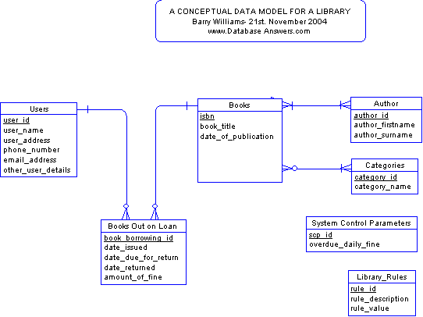
Notes:
http://www.databaseanswers.org/data_models/orders_parts/index.htm
Have a slde to expose ppl to normalization

Slide 52
Lab
Summary
Donald inc. is a market leader in the aircraft parts industry. Its primary business is in supplying aircraft materials. They are looking to scale up their business and believe that one key factor is digitizing their operations. They have approached you to design a database for them which can help them migrate their paper records effectively and in the future leverage the potential of machine learning / analytics.
Deliverables
You are expected to provide a ER model that accommodates their business requirements. The ER model should be efficiently designed and scalable with changing business goals.
Business Requirements
There are 3 ‘waves’ of requirements – each will be given to you sequentially.

Slide 53
Further Reading – for Friday and beyond
databaseanswers.org – Example schemas and tutorials
db-book.com – Normalization
Sqlzoo.net 0-6
Mid point presentations – idea, team, updates, roles + front end plan,

